Slide 1
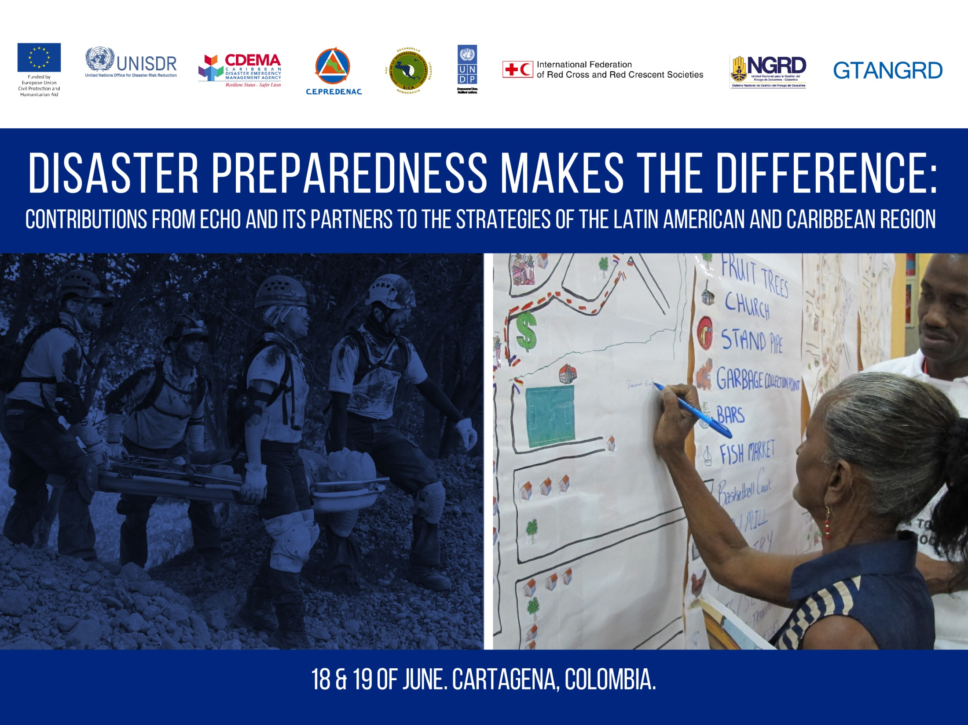
Ronald Jackson, Executive Director, CDEMA

Slide 2
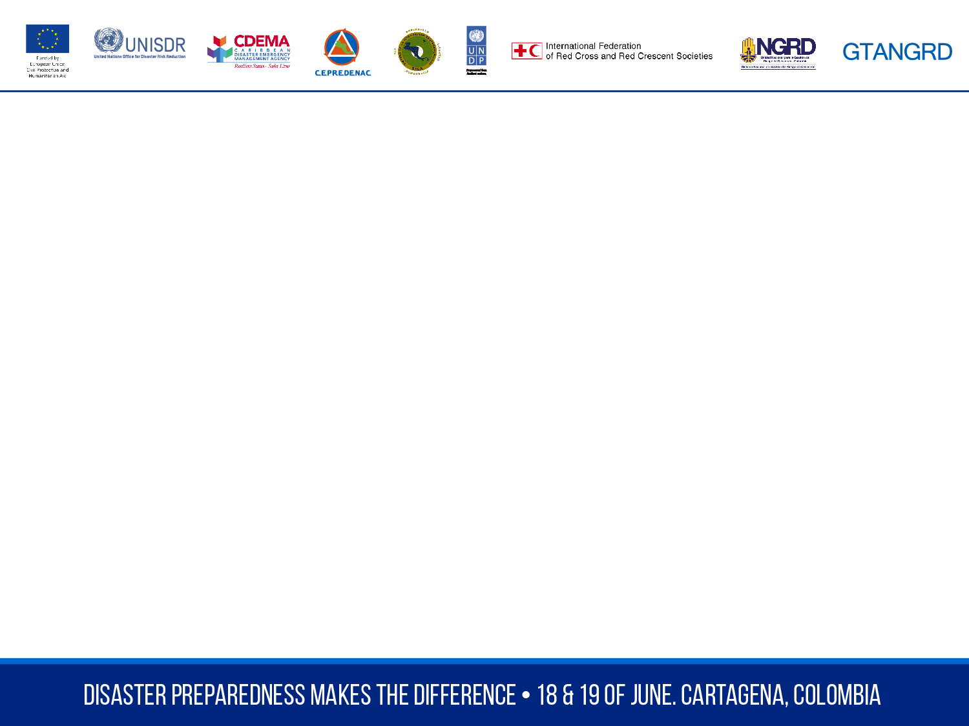
Regional Goal: Safer more resilient and sustainable Caribbean States
Institutional Strengthening
DM Organizations (national and regional) Strengthened for Supporting and monitoring the advancement of DRM
CDM Integrated into policy, strategy, legislation
Knowledge Management
Regional Network for Risk Informed Decision Making
Integrated System for fact based decision making at all levels
Sector Integration
Community Resilience
Strengthened Coordination for preparedness, response and recovery
Adequate resourcing of CDM Programming
Development Partner Programming aligned
Incorporation of Community and Sector Knowledge in Risk Assessments
Education and Training materials, standardized, improved and applied
Strategic Disaster Risk Management Programming for Priority Sectors
Hazard Information integrated into development planning and programming for priority sectors
Incentive programs developed and applied for the promotion of risk reduction/CCA in infrastructure investment
Standards for safe communities developed and applied
Community Based Disaster Management Capacity built/strengthened
Community EWS integrated, improved and expanded
Community Livelihoods safeguarded

Slide 3
Contributions to the CDM Strategy
Disaster Risk Reduction Priorities | CDM/Sendai Links | Timeframes
Early Warning Systems | CDM RO4.3 SDF P4
Community Resilience | CDM RO2.3, SENDAI P1 CDM PA1 (RO1.2) SDF P2
Capacity Building and Training | CDM regional priority 2 & 4
Institutional Strengthening | CDM: 1.4.; 2.3; 2.4 SDF: Priority 3 (a)
Public Private Partnership | CDM RO Area 3 Sendai Priority Action 3

Slide 4
Identifying the Evidence
Investment in EWS
  Mitigation investments at the Community Level (SKN):
  Support o building retrofitting
  Slope Stabilization (tree replanting)
Investment in organizing Community groups(ANU)

Slide 5
Identifying the Evidence
Haiti
  Early warning / Rapid assessment / Temporary shelters management
  Risk mapping / Simulation exercises / SOP’s updates / Awareness
  Multi-Hazard approach / Water storage capacities / Awareness / Coordination
  Operational capacities thanks to WASH cholera response set-up / Flexible funding envelops to partners / Stock pre-positioning
  Awareness / Evacuation / Mitigation works / Pre-positioned NFI distributions.

Slide 6
Outcomes of the interventions
Communities better prepared to respond to and cope with Hazard Impact.
Increased Knowledge and Awareness of Risks by Government Actors and Population
Better planning frameworks to advance EWS at the National and Community Level
Improved infrastructure for public notification and warning

Slide 7
Success Factors
The impacts of most investments made is usually realized several years after the project closes
However Adverse events allows us to observe how successful these investments are.
  Work of Community Groups and IFRC in ANU
  Resilience of housing stock in SKN
  Data gathering from rain and water level monitoring gauges
  Haiti’s decision support process (facilitating awareness of vulnerable areas and evacuating and sheltering Vulnerable populations)
  pre-positioning supplies and equipment

Slide 8
Communications/PR
Usually at two levels
  Project partners
  DIPECHO communication tools
Social Media
Video and Plays
Media Engagement

Slide 9
Recommended Enhancement
Sharing CDM Indicators for better alignment of evidence with CDM delivery
Continued engagement with CDEMA and Member States on Priority identification and matching initiatives that directly address these priorities

Slide 10
