Slide 1
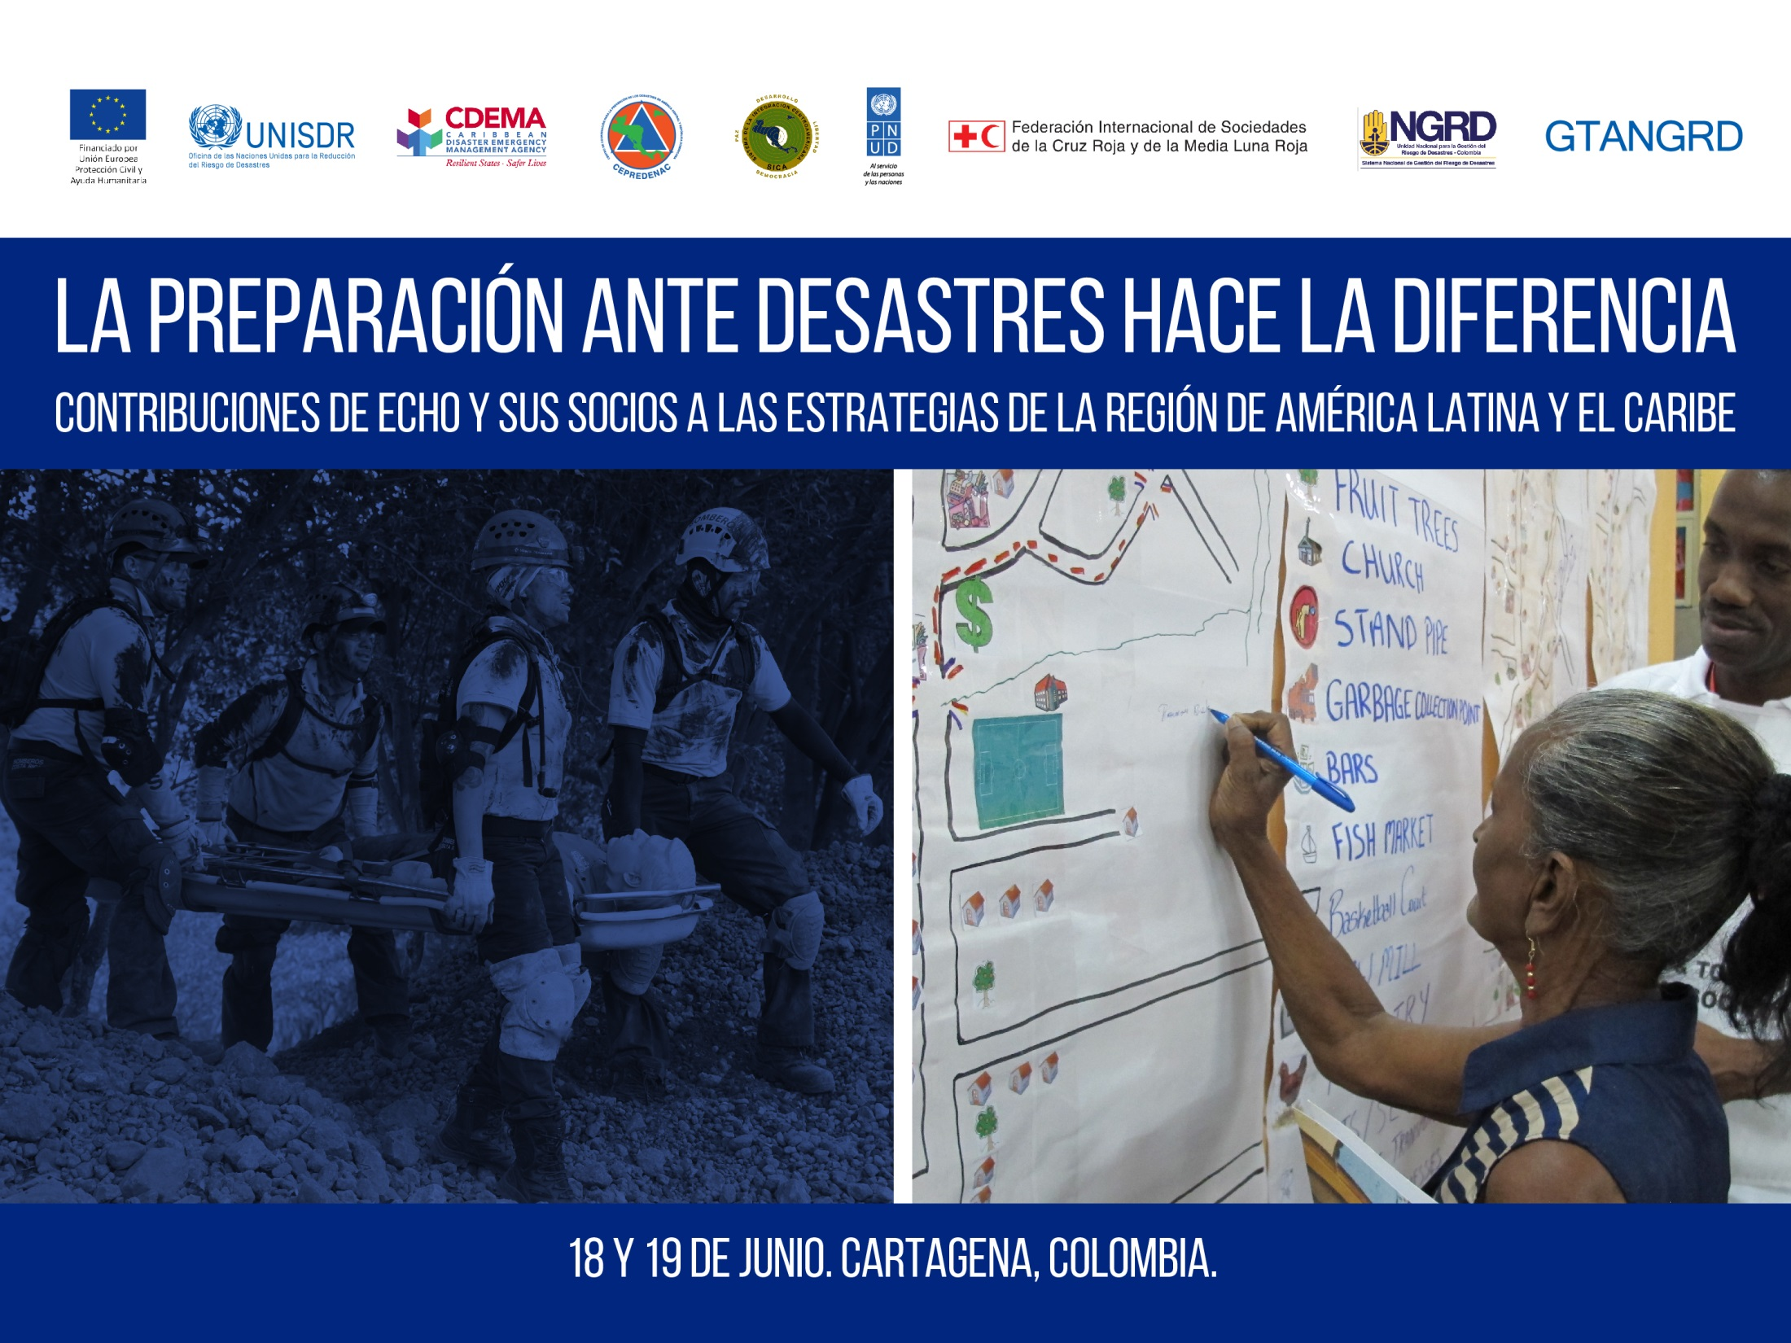
Towards the UNESCO/IOC-led CARIBE-EWS Community Performance Based Tsunami Recognition Programme in Honduras

Slide 2
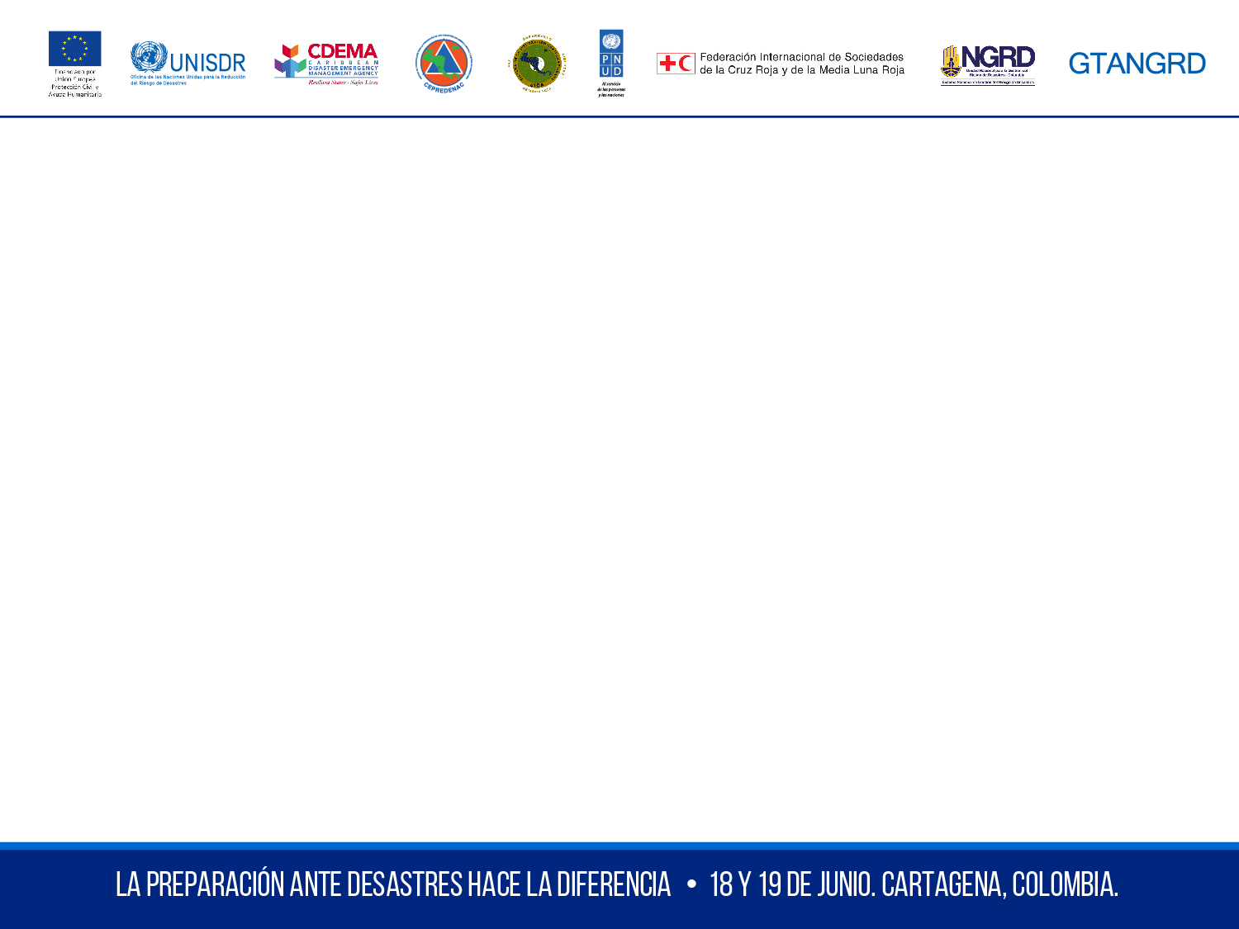
Overview
Tsunami Early Warning Systems (TEWS)
Education and TEWS
Towards CARIBE EWS Tsunami Ready
Making the Difference - Impact of Development of National TEWS, Education & Tsunami Ready - Jan 2018 North of Honduras Earthquake & Tsunami Response
Summary & Way Forward
Our project: ECHO/-CM/BUD/2016/91000 "Building Resilient Communities and Integrated Early Warning Systems for Tsunamis and Other Ocean-Related Hazards in Central America" 2016-2017

Slide 3
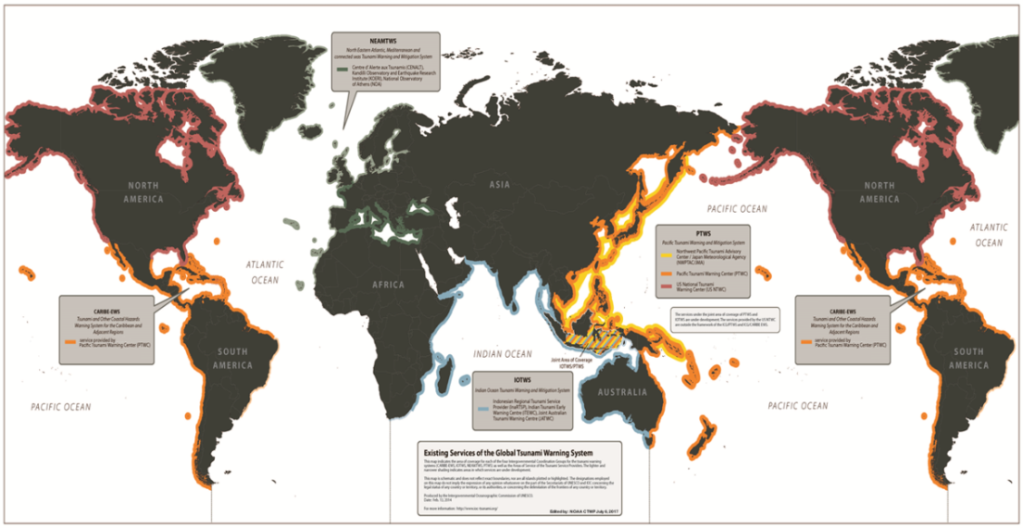
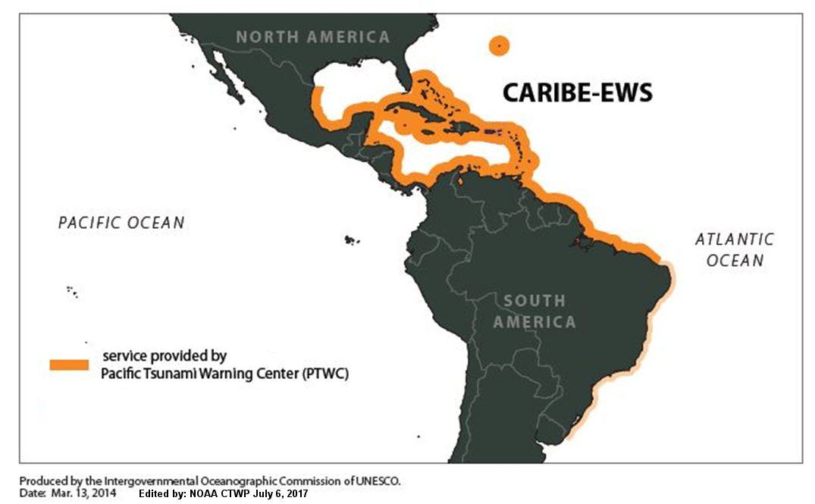
UNESCO IOC Intergovernmental Coordination Group for Tsunami and Other Coastal Hazards for the Caribbean and Adjacent Regions (CARIBE EWS)
32 MS and 16 Territories
(6 Associate MS of UNESCO);
16 SIDS

Slide 4
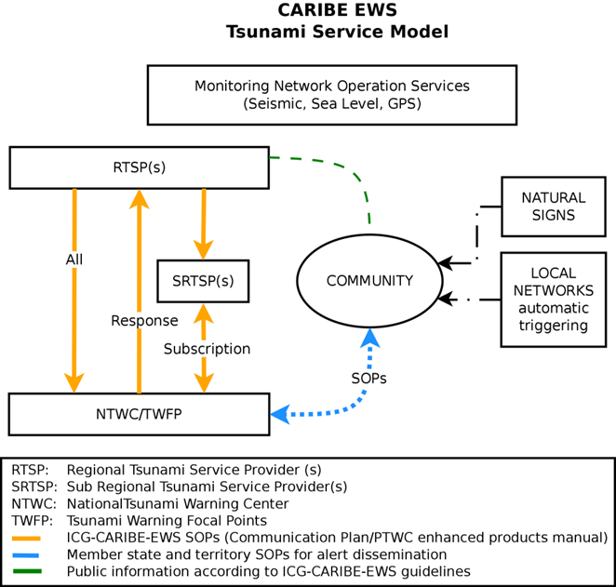
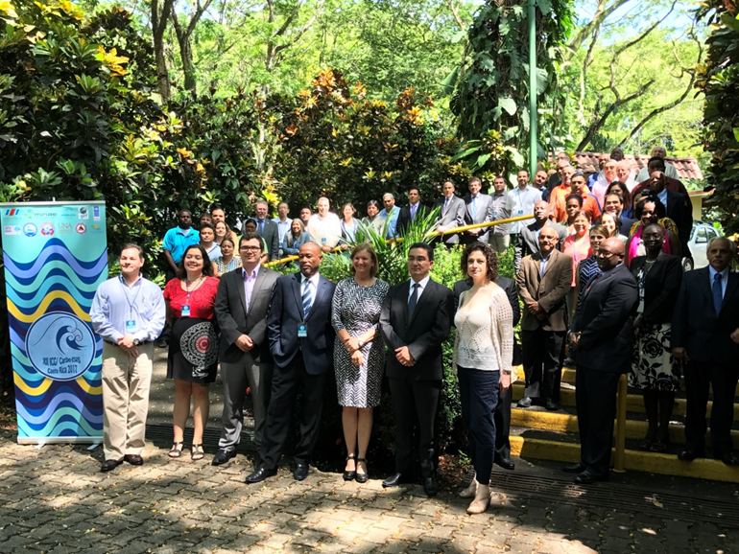
1. Tsunami Early Warning Systems (TEWS)
The CARIBE EWS Service Model
COMPONENTS
Monitoring & Detection
Hazard Assessment
Tsunami Services
Preparedness, Readiness & Resilience – Public information and Formal Education , Drills

Slide 5
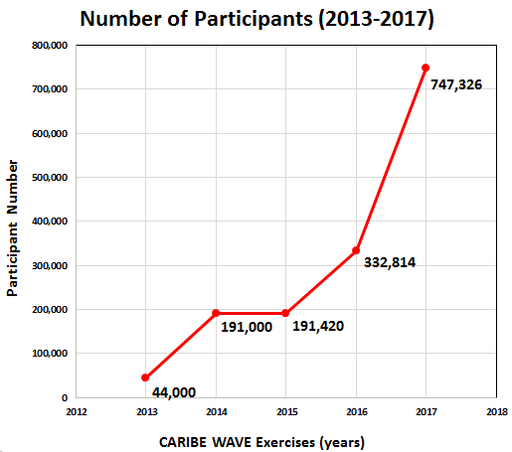
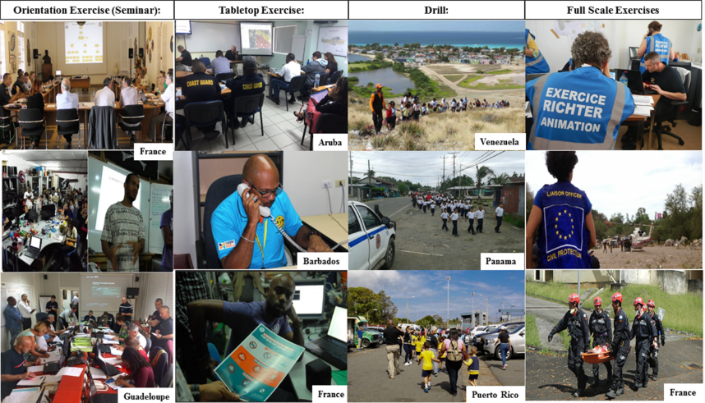
1. TEWS Feature: CARIBE WAVE 17
740,000 participants in CARIBE WAVE 17
Participation and feedback from all 32 Member States and 15/16 Territories
Communication systems between PTWC and MS Tested
National and Local Standard Operating Procedures were tested

Slide 6

2. Education and TEWS– Implementation in El Salvador, Honduras, Guatemala and Nicaragua
161 teachers trained
320 students and 235 parents trained on what is a tsunami, how it is generated, how it can be detected, how to prepare and how to be safe

Slide 7
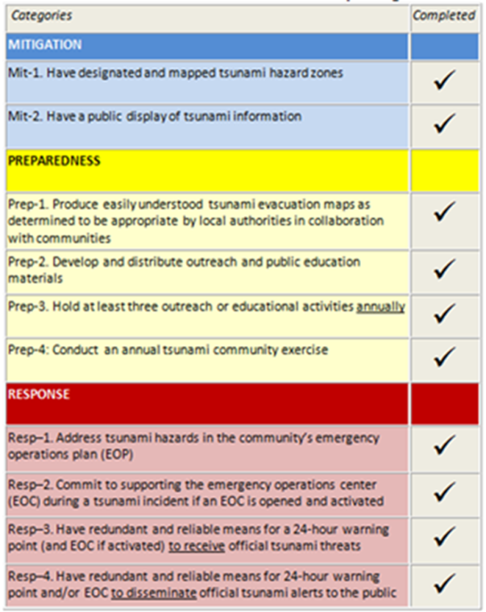
3. Towards CARIBE EWS Tsunami Ready - Key Components, Execution in Omoa, Honduras through ECHO-funded project
Pilot Performance Based Community Recognition Program
10 Guidelines that the community has to meet
6 international recognitions by UNESCO/IOC
Almost 200 communities TsunamiReady® in USA (including 54 in the Caribbean)

Slide 8
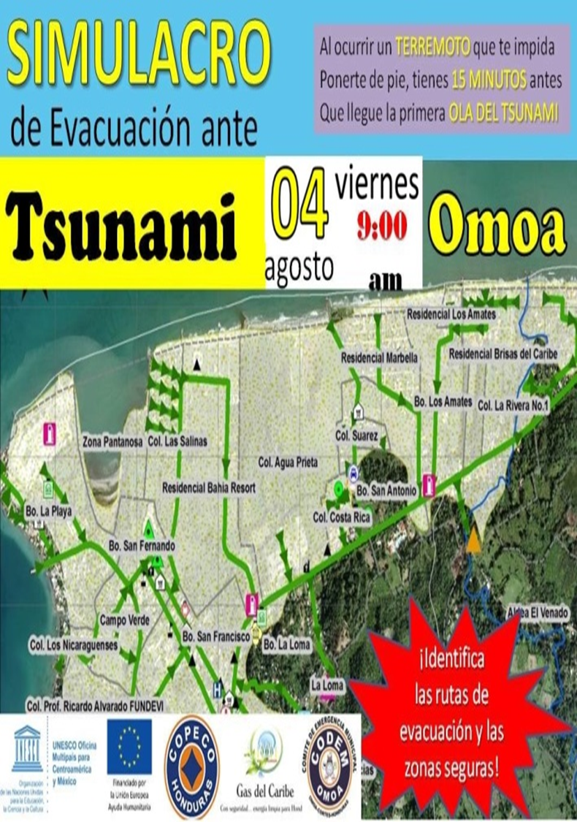
4. Marcando la diferencia – ejercicio de tsunami en Omoa, Honduras
Omoa prepara para Tsunami Ready
Video en español 2:32 minutos
https://www.youtube.com/watch?v=OlGXK-Cqk4s - YouTube

Slide 9
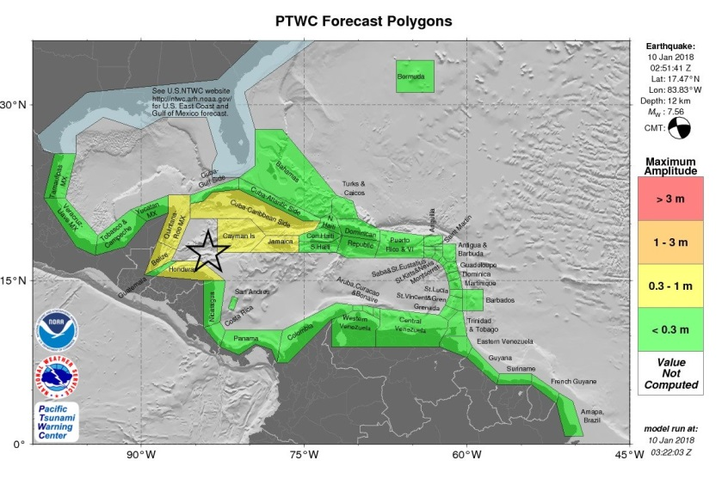
CARIBE EWS – TSUNAMI THREAT MESSAGE
TSUNAMI MESSAGE NUMBER 1
NWS PACIFIC TSUNAMI WARNING CENTER EWA BEACH HI
0257 UTC WED JAN 10 2018
10,de enero 2018 a las 2h51 UTC (9 de enero, 8:51 PM tiempo local) un terremoto de Mw 7.6 ocurrió cotsa afuera de Swan Island (Honduras). Afortunadamente, el terremoto no causó mayor daño y el tsunami fue pequeño. Fue la primera vez que el Centro de Alerta de Tsunami del Pacífico (PTWC) emitió una alerta de tsunami para el Caribe desde la implementación completa en 2016 de los productos mejorados para el Sistema de la UNESCO-COI para Alerta de Tsunami y otras amenazas costeras para el Caribe y regiones adyacentes (CARIBE SAT).
HAZARDOUS TSUNAMI WAVES FROM THIS EARTHQUAKE ARE POSSIBLE WITHIN 1000 KM OF THE EPICENTER ALONG THE COASTS OF
CAYMAN ISLANDS... JAMAICA... MEXICO... HONDURAS... CUBA...BELIZE... SAN ANDRES PROVID... COSTA RICA... PANAMA...NICARAGUA AND GUATEMALA

Slide 10
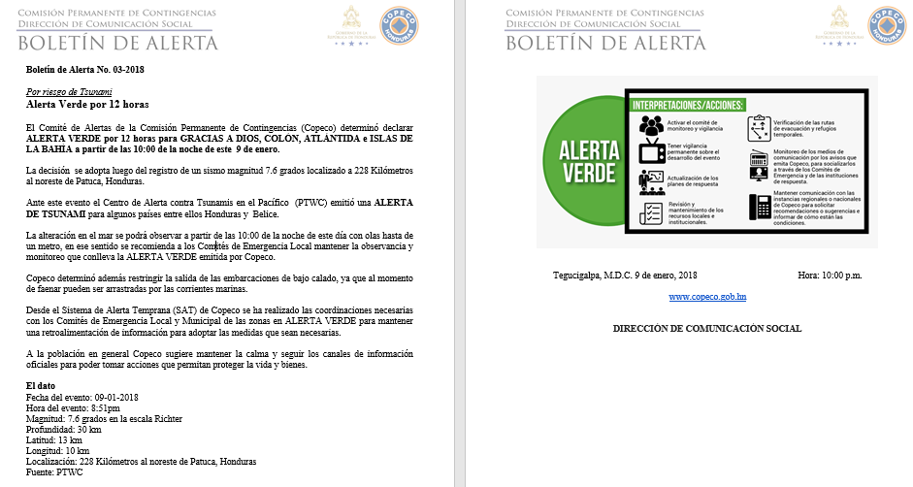

Slide 11
ICG/CARIBE EWS: Achievements & Gaps
“Tsunami Ready” – global harmonisation and implementation within all regional TEWS through UNESCO/IOC coordination mechanism - Working Group on Tsunamis and Other Hazards Related to Sea-Level Warning and Mitigation Systems (TOWS)
MHEWS framework – Genesis & 2017 Atlantic Hurricane Season
For CARIBE EWS, 2018 North of Honduras Earthquake and Tsunami was a Good First Real Test of the System/Work in progress
At national and local levels the response showed that in case of a damaging real event, the community of Omoa will save a lot of lives thanks to its tsunami preparedness
Monitoring and Detection – gaps, damage & elimination of equipment
Hazard Assessment – limited baseline data and national capacity
Tsunami Services – delays, interpretation challenges
Regional assessment highlighted the need for additional national and local capacity building and education

Slide 12
ICG/CARIBE EWS Way Forward … Coming soon
Pacific Tsunami Warning Center (RTSP) assessing potential to further enhance information for ICG/CARIBE EWS Member States to include travel times
ICG/CARIBE EWS Implementation Plan 2018 – 2023:
Support rehabilitation of regional tsunami monitoring and detection network
Continued support to capacity building training for hazard assessment, warning communication and dissemination
Continued implementation of CARIBE EWS Tsunami Ready Program by Member States and Partners to address key components of TEWS:
ECHO/-AM/BUD/2018/91017 - "Strengthening Early Warning and Response Capacities for Tsunami and Other Coastal Hazards in Central America” 2018-2019
ECHO Project Proposal “Strengthening Capacities of Early Warning and Response for Tsunamis and Other Coastal Hazards in the Caribbean” undergoing negotiations 2018-2019

Slide 13
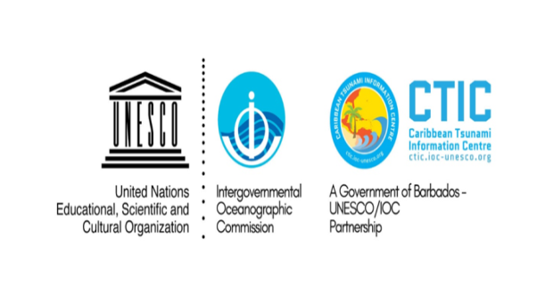
Thank you!
¡Muchas gracias!
Alison Brome - a.brome@unesco.org
Bernardo Aliaga – b.aliaga@unesco.org
Astrid Hollander – a.hollander@unesco.org

