Slide 1
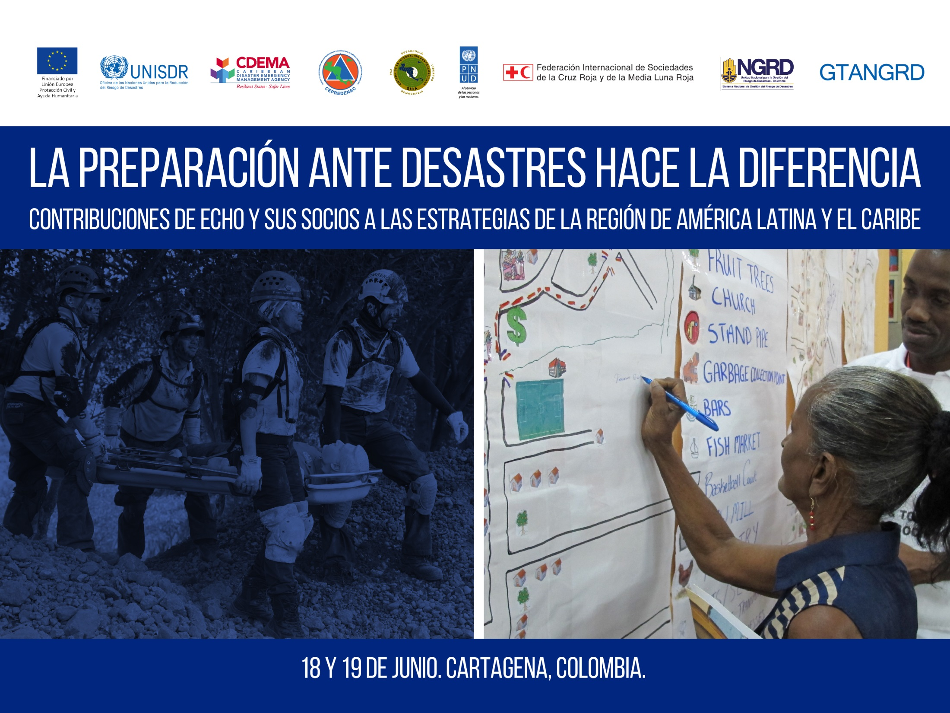
MULTI-HAZARD EARLY WARNING SYSTEMS: A CHECKLIST
(Revised 2018)

Slide 2

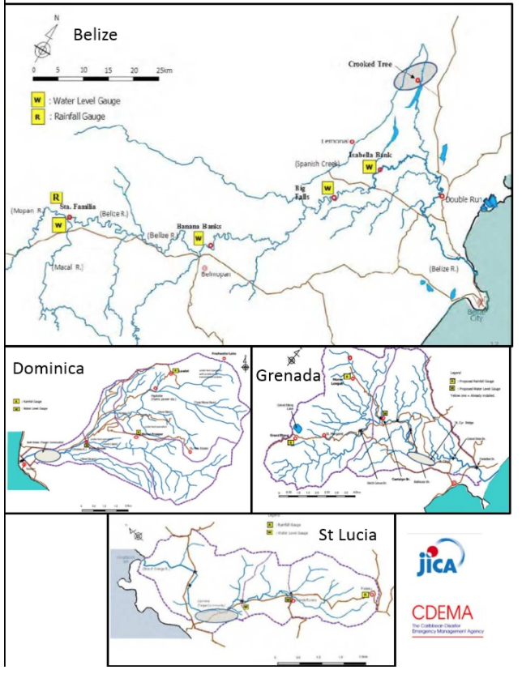
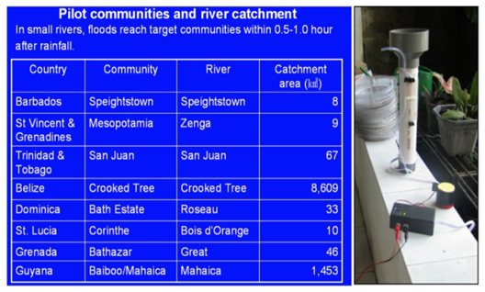
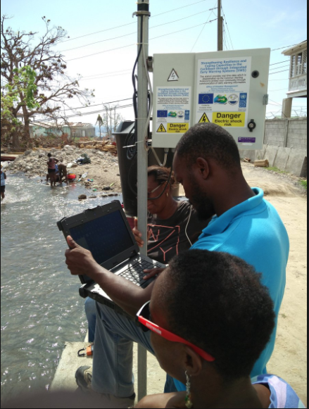

BACKGROUND: CARIBBEAN CONTEXT
Notes:
The recognition of the need for the MHEWS Checklist in the Caribbean comes against the backdrop of the Numerous EWS interventions at all levels including but not limited to ofcourse the Framework for sustaining EWS advances beyond the life of projects under Caribbean Disaster Management Project (CADM), CAP, etc. These interventions are useful building blocks for contributing to fully functional MHEWS but there has been no comprehensive set of elements/standards in use covering the 4 pillars of an EWS in the Region for ensuring that MHEWS are complete.

Slide 3
The MHEWS Checklist: Application and Outcomes
Standardized approach to assessing MHEWS in the Caribbean
Improved understanding of status of MHEWS in 6 countries resulting in:
  National gap analyses - Dominican Republic, Saint Lucia, Saint Vincent and the Grenadines, Antigua & Barbuda, Dominica and Cuba
  Draft Inputs for National MHEWS Roadmaps
Broad stakeholder engagement in national MHEWS assessment process
  250 responses from agencies at national and local levels across the five countries

Slide 4
Standardized approach to assessing MHEWS in the Caribbean
Improvements under the DIPECHO 2017-2018 Project
Integration of gender considerations
Inclusion of major social groups as key actors
Inclusion of general information on the population to be served
Development of levels against which to objectively identify attainment/progress for each action, and
Minimal revisions to the language of the Checklist for improved clarity
Notes:
The need for an EWS checklist has been traced back to the Hyogo Framework for Action and precipitated through the Third International Conference on Early Warning (EWC III) held in Bonn, Germany (2006) where UNISDR through an expert group developed the checklist to be:
a simple list of the main elements and actions
a practical, non-technical reference tool to ensure that the major elements of a good early warning system are in place acknowledging that is not intended to be a comprehensive design manual
This Checklist was revisited last year at the Multi-Hazard Early Warning Conference (MHEWC) in Cancún, Mexico in 2017 and as of Feb 2018 it has been adapted for use in the Caribbean under the project ‘‘Strengthening integrated early warning systems for more effective disaster risk reduction in the Caribbean through knowledge and tool transfer’.
Revisions included:
the integration of gender considerations across the four pillars of the Checklist
the inclusion of major social groups and other stakeholders among the key actors
the inclusion of general information on the population to be served by the MHEWS
the development of levels against which to objectively identify attainment/progress for each action, and
the minimal revisions to the language of the Checklist for improved clarity
This most recent revision was led by the Caribbean Disaster Emergency Management Agency (CDEMA) with support from the United Nations Development Program (UNDP), the International Federation of the Red Cross and the Red Crescent Societies (IFRC) and Handicap International. This Project was funded through the DIPECHO Action Plan for the Caribbean (2017) by the General Directorate of Civil Protection and Humanitarian Aid of the European Union (ECHO).

Slide 5
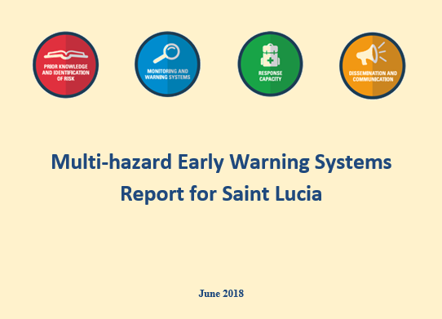
National MHEWS Gap Analyses
National MHEWS Gaps presenting weakness and challenges of countries such as:
  A clear gap on risk knowledge
  Major legislative gap noting for example that some countries have drafted legislation but they have not been enacted
  Issue with forecasting and communicating risk probability. The need to create plans based on probable risk scenarios has been identified.
Notes:
Some of the common gaps identified include:
A clear gap on risk knowledge
Major legislative gap noting for example that some countries have drafted legislation but they have not been enacted
Issue with forecasting and communicating risk probability. The need to create plans based on probable risk scenarios has been identified.

Slide 6
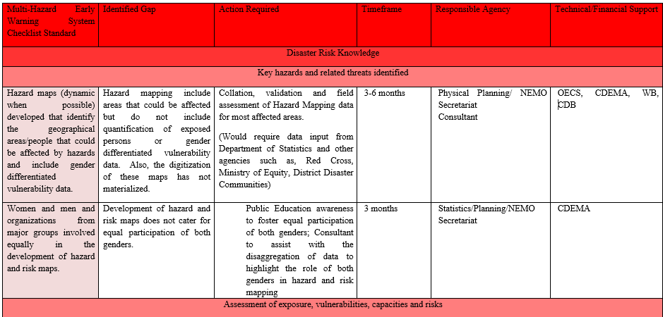
National MHEWS Roadmaps: Path to Successful MHEWS
  Opportunities for internal national and regional programming to improve systems
  Opportunities for targeted donor support noting the Caribbean context

Slide 7
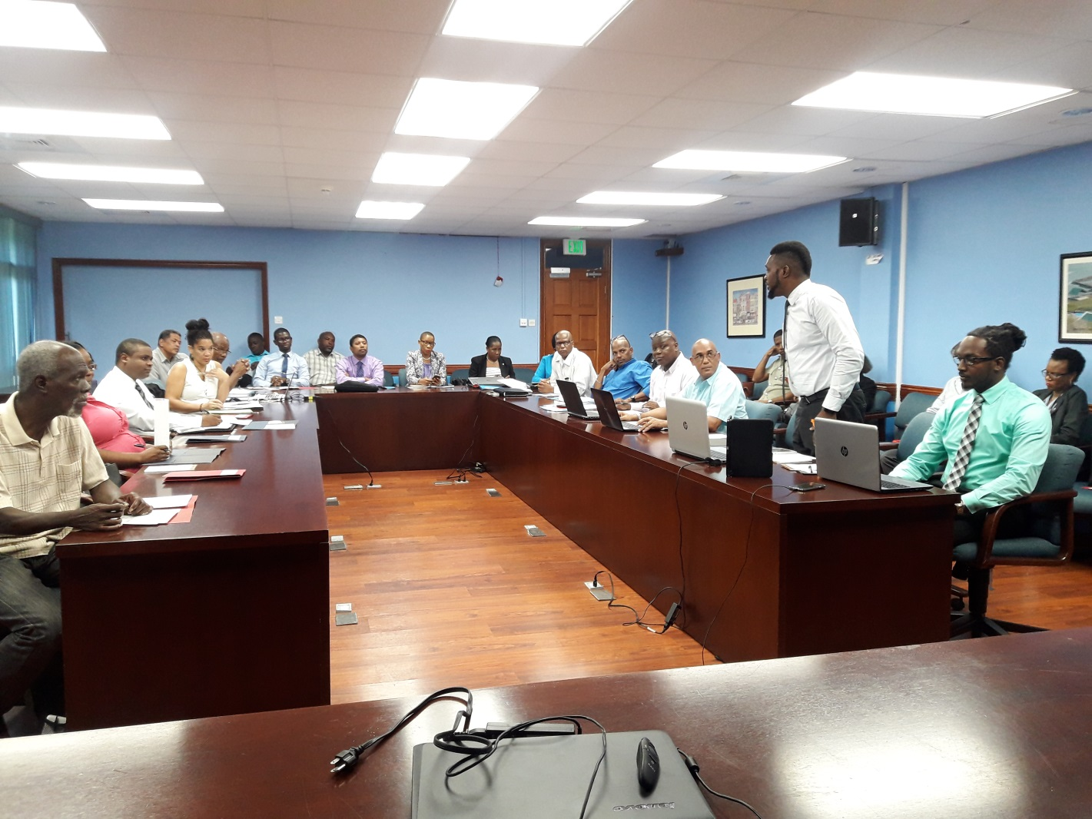
Broad Stakeholder Engagement: A Vehicle to Achieve Successful MHEWS
  Stakeholders involved in Validating MHEWS Gaps in Saint Lucia
  Number of respondents from agencies at national and local levels across the 5 countries
Notes:
Across the 5 countries there have been 250 responses from agencies at national to local levels and across sectors. Broad stakeholder engagement at the beginning from assessment to roadmap development and through to implementation will be an important determining factor for the successful integration of MHEWS into national programming.

Slide 8
Lessons learnt from application of MHEWS Checklist
Sensitisation for improved response rates and quality of data
Complementary approaches for data collection should be encouraged eg. Interviews for non-technical community persons
Anonymity should be upheld to allow for open sharing of information on status of EWS element
Notes:
Across the 5 countries there have been 250 responses from agencies at national to local levels and across sectors. Broad stakeholder engagement at the beginning from assessment to roadmap development and through to implementation will be an important determining factor for the successful integration of MHEWS into national programming.

Slide 9

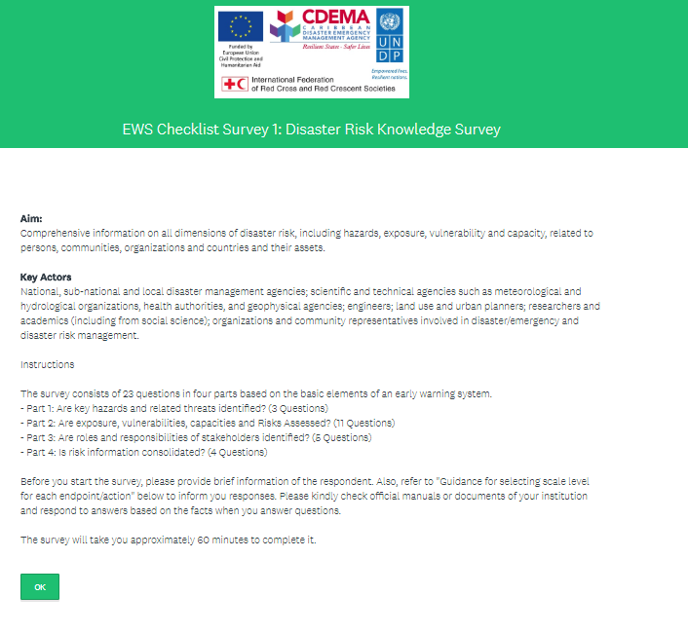
Lessons learnt from application of MHEWS Checklist Cont’d
The Checklist allows for a logical approach to developing National MHEWS Roadmap
Checklist Application
Gap analysis
Validation exercise
Roadmap Development
Notes:
Across the 5 countries there have been 250 responses from agencies at national to local levels and across sectors. Broad stakeholder engagement at the beginning from assessment to roadmap development and through to implementation will be an important determining factor for the successful integration of MHEWS into national programming.

Slide 10


